Slide 1
UPPER SIXTH ARTS
GEOGRAPHY
Map Analysis 8
Rural Settlements on Maps
Notes:
Good morning, class, and welcome to our geography lesson. I am your geography teacher, Mr Kamdem. Today we are starting Map Analysis 8: Rural Settlements on Maps.

Slide 2
CLASS INFO
Class, Chapter and Duration
Class | Upper Sixth Arts
Chapter | Module 8: Understanding and carrying out statistical techniques, topographic map analysis, fieldwork and project based learning
Duration | 2 periods (2 × 50 minutes)
Notes:
This lesson is for Upper Sixth Arts. It belongs to Module 8: Understanding and carrying out statistical techniques, topographic map analysis, fieldwork and project based learning. We shall need 2 periods to cover it.

Slide 3
IDENTIFICATION
Lesson Identification
Topic | Topographic Map Analysis
Sub-topic | Settlement Analysis
Lesson | Map Analysis 8: Rural Settlements on Maps
Notions / Concepts | Site, situation, nucleated, linear, dispersed, settlement pattern, Nearest Neighbour Index.
Syllabus focus | Site and situation from map evidence; factors of siting; rural settlement forms and patterns; distribution; Nearest Neighbour Index.
Competence | Learners are able to explain the siting and patterns of rural settlements from maps and calculate the NNI.
Notes:
Our topic is Topographic Map Analysis, and the sub-topic is Settlement Analysis. The key notions we shall use today are: site, situation, nucleated, linear, dispersed, settlement pattern, Nearest Neighbour Index. At the end, you should be able to do this: learners are able to explain the siting and patterns of rural settlements from maps and calculate the NNI.

Slide 4

HOMEWORK CORRECTION
Correction of the Homework
Question (Map Analysis 7: Land Use on Maps):
Map the land uses along the road from your home to school.
Notes:
Before we start the new lesson, let us correct the homework I gave you at the end of Map Analysis 7: Land Use on Maps. The question was: Map the land uses along the road from your home to school. Take out your exercise books.

Slide 5
HOMEWORK CORRECTION
Correction: Possible Answer
Answers vary. Example: houses and shops near home, a market, a garage and a church along the road, maize farms on the outskirts and the school at the end.
Notes:
Here is a good answer. Answers vary. Example: houses and shops near home, a market, a garage and a church along the road, maize farms on the outskirts and the school at the end. Compare it with your own answer and correct your work in red.

Slide 6
LESSON PLAN
Lesson Plan
Correction of the homework
Objectives and recall
Real-life situation and action to take
Learning activities
Board summary
Evaluation, remediation and homework
Notes:
Here is the plan of our lesson today. First, we shall correct the homework. Then we shall look at the objectives and recall what you already know. After that, we shall study a situation from real life and the action to take, and do the learning activities. Finally, we shall copy the board summary, do the evaluation and the remediation, and I will give you the homework.

Slide 7
OBJECTIVES
Objectives
By the end of this lesson, you should be able to:
Explain the site and situation of settlements from map evidence.
Identify settlement forms and patterns.
Notes:
Take your time to copy this part; we will continue together.

Slide 8
OBJECTIVES
Objectives (continued)
Calculate and interpret the Nearest Neighbour Index.
Notes:
By the end of this lesson, you should be able to do three things. Number 1: explain the site and situation of settlements from map evidence. Number 2: identify settlement forms and patterns. Number 3: calculate and interpret the Nearest Neighbour Index.

Slide 9
PREVIOUS KNOWLEDGE
Previous Knowledge
Villages can be nucleated, linear or dispersed.
NNI measures settlement patterns.
Notes:
Let us first remember what you already know. Villages can be nucleated, linear or dispersed. NNI measures settlement patterns. Keep this in mind, because we shall build on it today.

Slide 10
REAL-LIFE SITUATION
Situation in Real Life
On a map extract, some huts cluster at a river crossing, others line a road and others are scattered on hills. The class must describe and explain these patterns.
Notes:
Listen carefully to this situation from real life. On a map extract, some huts cluster at a river crossing, others line a road and others are scattered on hills. The class must describe and explain these patterns. Think about it, because I am going to ask you some questions.

Slide 11
REAL-LIFE SITUATION
Situation: Question 1
What is the problem in the situation?
Notes:
Question 1: What is the problem in the situation? Think for a moment, then raise your hand to answer.

Slide 12
REAL-LIFE SITUATION
Answer
The class must explain settlement patterns.
Notes:
Good. The class must explain settlement patterns.

Slide 13
REAL-LIFE SITUATION
Situation: Question 2
Which pattern is along the road?
Notes:
Question 2: Which pattern is along the road? Think for a moment, then raise your hand to answer.

Slide 14
REAL-LIFE SITUATION
Answer
Linear.
Notes:
Good. Linear.

Slide 15
REAL-LIFE SITUATION
Situation: Question 3
Which index measures the pattern?
Notes:
Question 3: Which index measures the pattern? Think for a moment, then raise your hand to answer.

Slide 16
REAL-LIFE SITUATION
Possible Answer
The Nearest Neighbour Index (NNI).
Notes:
Good. The Nearest Neighbour Index (NNI).

Slide 17
ACTION TO TAKE
Action to Take
Describe settlements with map evidence and measure their pattern.
Notes:
From this situation, the action we are working towards in this lesson is the following: describe settlements with map evidence and measure their pattern.

Slide 18
JUSTIFICATION
Justification of the Lesson
This lesson helps us to analyse rural settlements on maps.
Notes:
Why is this lesson important for you? This lesson helps us to analyse rural settlements on maps.

Slide 19
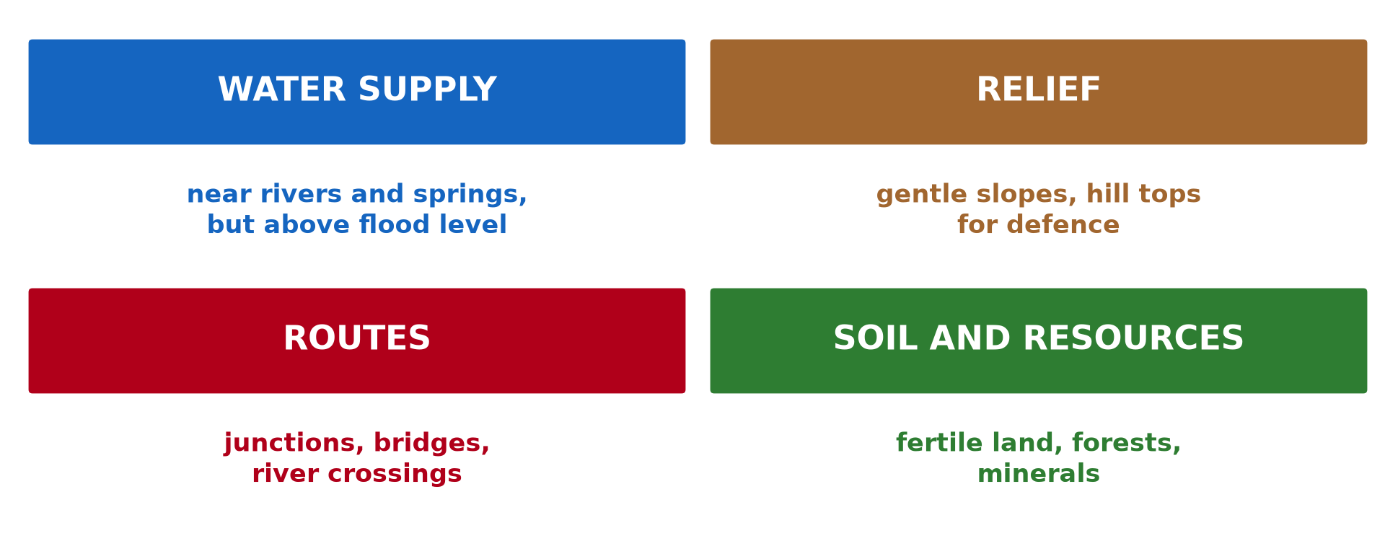
1. SITE FACTORS
Activity 1
Siting factors.
Notes:
Activity 1. Look carefully at this diagram: siting factors. Observe every detail before I ask the question.

Slide 20
1. SITE FACTORS
Activity 1: Question
Give three factors that influence the site of a village.
Notes:
Here is the question for Activity 1: Give three factors that influence the site of a village. Take one minute to think and write your answer in your rough notebook.

Slide 21
1. SITE FACTORS
Activity 1: Answer
Water supply, gentle relief and routes (also fertile soil).
Notes:
Let us check the answer together. Water supply, gentle relief and routes (also fertile soil).

Slide 22
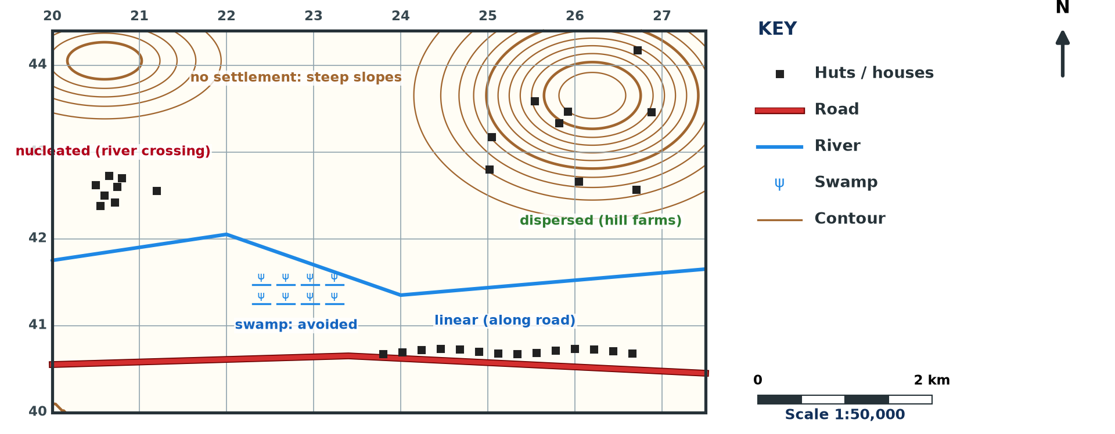
2. FORMS AND PATTERNS
Activity 2
Settlements on a map (invented).
Notes:
Activity 2. Look carefully at this diagram: settlements on a map (invented). Observe every detail before I ask the question.

Slide 23
2. FORMS AND PATTERNS
Activity 2: Question
Identify three settlement patterns on the extract.
Notes:
Here is the question for Activity 2: Identify three settlement patterns on the extract. Take one minute to think and write your answer in your rough notebook.

Slide 24
2. FORMS AND PATTERNS
Activity 2: Answer
Nucleated at the river crossing, linear along the road and dispersed on the hills.
Notes:
Let us check the answer together. Nucleated at the river crossing, linear along the road and dispersed on the hills.

Slide 25

2. EXPLANATION
Activity 3
Settlement patterns.
Notes:
Activity 3. Look carefully at this diagram: settlement patterns. Observe every detail before I ask the question.

Slide 26
2. EXPLANATION
Activity 3: Question
Why are there no settlements on steep slopes or swamps?
Notes:
Here is the question for Activity 3: Why are there no settlements on steep slopes or swamps? Take one minute to think and write your answer in your rough notebook.

Slide 27
2. EXPLANATION
Activity 3: Answer
They are hard to build on, farm and reach; swamps flood.
Notes:
Let us check the answer together. They are hard to build on, farm and reach; swamps flood.

Slide 28
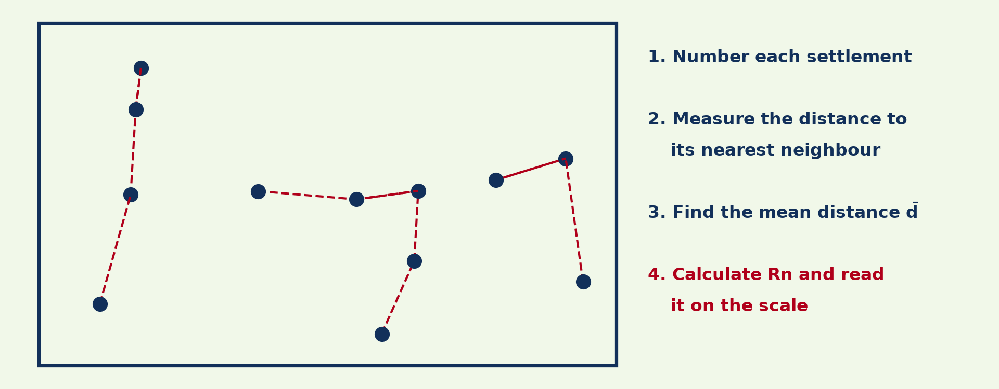
3. NNI METHOD
Activity 4
Measuring nearest neighbours.
Notes:
Activity 4. Look carefully at this diagram: measuring nearest neighbours. Observe every detail before I ask the question.

Slide 29
3. NNI METHOD
Activity 4: Question
Write the NNI formula.
Notes:
Here is the question for Activity 4: Write the NNI formula. Take one minute to think and write your answer in your rough notebook.

Slide 30
3. NNI METHOD
Activity 4: Answer
Rn = 2 d̄ √(n ÷ A).
Notes:
Let us check the answer together. Rn = 2 d̄ √(n ÷ A).

Slide 31
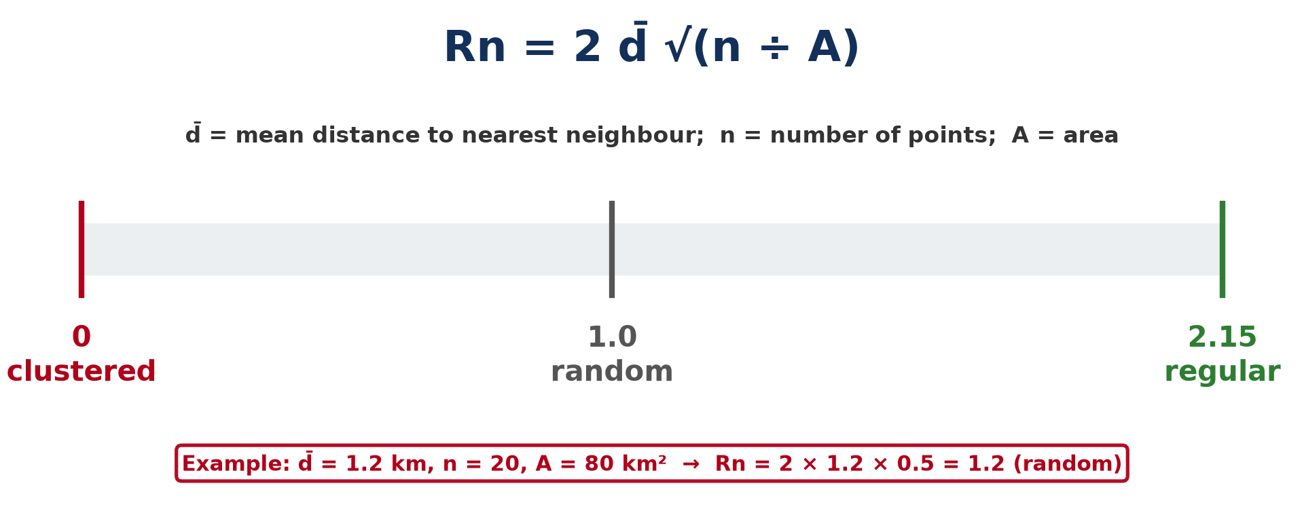
3. NNI INTERPRETATION
Activity 5
NNI scale.
Notes:
Activity 5. Look carefully at this diagram: nNI scale. Observe every detail before I ask the question.

Slide 32
3. NNI INTERPRETATION
Activity 5: Question
Interpret Rn = 0.4 and Rn = 1.8.
Notes:
Here is the question for Activity 5: Interpret Rn = 0.4 and Rn = 1.8. Take one minute to think and write your answer in your rough notebook.

Slide 33
3. NNI INTERPRETATION
Activity 5: Answer
0.4: clustered (nucleated). 1.8: fairly regular (dispersed).
Notes:
Let us check the answer together. 0.4: clustered (nucleated). 1.8: fairly regular (dispersed).

Slide 34
BOARD SUMMARY
Board Summary
Topic: Topographic Map Analysis
Sub-topic: Settlement Analysis
Map Analysis 8: Rural Settlements on Maps
Notes:
Now we are going to copy the board summary. Write the title and the headings neatly in your notebooks. I will give you enough time for each slide, so do not rush.

Slide 35
BOARD SUMMARY
DEFINITIONS
The key terms of this lesson are defined as follows:
Site: It is the actual land on which a settlement is built. It is described by relief, water supply and soil.
Notes:
Let us copy the definitions. The key terms of this lesson are defined as follows. On this slide we have Site. Write each point on a new line, with the key term first, and explain it in your own words when we revise. When you finish, we go to the next slide.

Slide 36
BOARD SUMMARY
DEFINITIONS (continued)
Situation: It is the position of a settlement in relation to surrounding features such as routes, rivers and other towns. It explains its growth.
Notes:
We continue with the definitions. On this slide we have Situation. Write each point on a new line, with the key term first, and explain it in your own words when we revise.

Slide 37
BOARD SUMMARY
1. Site and Situation from Map Evidence
The site of rural settlements is explained by the following factors:
Physical factors: Settlements choose gentle slopes, a water supply and fertile soil above flood level. Steep slopes and swamps are avoided.
Notes:
Let us copy Site and Situation from Map Evidence. The site of rural settlements is explained by the following factors. On this slide we have Physical factors. Write each point on a new line, with the key term first, and explain it in your own words when we revise. When you finish, we go to the next slide.

Slide 38
BOARD SUMMARY
1. Site and Situation from Map Evidence (continued)
Human factors: Settlements grow at route centres, river crossings and near markets. Defence and history also influence the site.
Notes:
We continue with Site and Situation from Map Evidence. On this slide we have Human factors. Write each point on a new line, with the key term first, and explain it in your own words when we revise.

Slide 39
BOARD SUMMARY
1. Site and Situation from Map Evidence
Illustration: siting factors
Notes:
Now draw this illustration in your notebook: siting factors. Give it a title and label it clearly.

Slide 40
BOARD SUMMARY
2. Rural Settlement Forms and Patterns
Rural settlements take the following forms:
Nucleated pattern: Houses are grouped closely together, often at a river crossing or road junction. It favours defence and sharing services.
Notes:
Let us copy Rural Settlement Forms and Patterns. Rural settlements take the following forms. On this slide we have Nucleated pattern. Write each point on a new line, with the key term first, and explain it in your own words when we revise. When you finish, we go to the next slide.

Slide 41
BOARD SUMMARY
2. Rural Settlement Forms and Patterns (continued)
Linear pattern: Houses are built in a line along a road, river or ridge. It gives easy access to transport.
Dispersed pattern: Houses are scattered, often on hills or large farms. Each family lives near its own land.
Notes:
We continue with Rural Settlement Forms and Patterns. On this slide we have Linear pattern and Dispersed pattern. Write each point on a new line, with the key term first, and explain it in your own words when we revise.

Slide 42
BOARD SUMMARY
2. Rural Settlement Forms and Patterns
Illustration: settlement patterns
Notes:
Now draw this illustration in your notebook: settlement patterns. Give it a title and label it clearly.

Slide 43
BOARD SUMMARY
3. Nearest Neighbour Index (NNI)
The NNI measures settlement patterns as follows:
Formula: Rn = 2 d̄ √(n ÷ A), where d̄ is the mean nearest-neighbour distance, n the number of points and A the area. Distances are measured in the same unit as the area.
Notes:
Let us copy Nearest Neighbour Index (NNI). The NNI measures settlement patterns as follows. On this slide we have Formula. Write each point on a new line, with the key term first, and explain it in your own words when we revise. When you finish, we go to the next slide.

Slide 44
BOARD SUMMARY
3. Nearest Neighbour Index (NNI) (continued)
Interpretation: Rn = 0 is fully clustered, Rn = 1 is random and Rn = 2.15 is perfectly regular. Values near 0.5 show nucleation, and values above 1.5 show dispersion.
Notes:
We continue with Nearest Neighbour Index (NNI). On this slide we have Interpretation. Write each point on a new line, with the key term first, and explain it in your own words when we revise.

Slide 45
BOARD SUMMARY
3. Nearest Neighbour Index (NNI)
Illustration: NNI scale
Notes:
Now draw this illustration in your notebook: nNI scale. Give it a title and label it clearly.

Slide 46
FORMATIVE EVALUATION
Evaluation 1
n = 16, A = 16 km², d̄ = 0.5 km. Find Rn.
Notes:
Now let us check what you have understood. Question 1: n = 16, A = 16 km², d̄ = 0.5 km. Find Rn. Answer in your exercise book.

Slide 47
FORMATIVE EVALUATION
Expected Answer
2 × 0.5 × √(16 ÷ 16) = 1.0: random.
Notes:
The expected answer is: 2 × 0.5 × √(16 ÷ 16) = 1.0: random. If you got it right, well done.

Slide 48
FORMATIVE EVALUATION
Evaluation 2
Give two reasons for linear settlements.
Notes:
Now let us check what you have understood. Question 2: Give two reasons for linear settlements. Answer in your exercise book.

Slide 49
FORMATIVE EVALUATION
Expected Answer
Along roads for transport and along rivers for water.
Notes:
The expected answer is: along roads for transport and along rivers for water. If you got it right, well done.

Slide 50
REMEDIATION
Remediation
Fill in the blanks:
The land a village is built on is its ______.
Rn = 1.0 means ______.
Huts along a road form a ______ pattern.
Notes:
For those who need more practice, fill in the blanks in your exercise book. The answers are: number 1, site; number 2, random; number 3, linear.

Slide 51
HOMEWORK
Homework
Calculate the NNI for the huts in one grid square of a map extract.
Notes:
For your homework: Calculate the NNI for the huts in one grid square of a map extract. We shall correct it at the beginning of our next lesson.

Slide 52
NEXT LESSON
Next Lesson
Our next lesson will be on:
Map Analysis 9: Urban Settlements on Maps
Notes:
Our next lesson will be on Map Analysis 9: Urban Settlements on Maps. Thank you for your attention, and see you next time.

Slide 53
BILINGUAL GAME
Bilingual Game (Jeu Bilingue)
English | Français
Village | Le village
Site | Le site
Pattern | La forme de répartition
Nucleated | Groupé
Dispersed | Dispersé
Linear | Linéaire
Notes:
Let us play the bilingual game. I say a word in English, and you give me the French word. Then we do the reverse.

Slide 54
LOGBOOK
Official Logbook (1/2)
Module / Topic | Topographic Map Analysis
Lesson Title | Map Analysis 8: Rural Settlements on Maps
Expected Learning Outcomes | Explain the site and situation of settlements from map evidence. Identify settlement forms and patterns. Calculate and interpret the Nearest Neighbour Index.
Competence | Learners are able to explain the siting and patterns of rural settlements from maps and calculate the NNI.
Notes:
I record this information in the official logbook of the class after the lesson.

Slide 55
LOGBOOK
Official Logbook (2/2)
Matter Taught | DEFINITIONS; Site and Situation from Map Evidence; Rural Settlement Forms and Patterns; Nearest Neighbour Index (NNI).
Evaluation | Formative evaluation and remediation exercise.
Homework | Calculate the NNI for the huts in one grid square of a map extract.
Enrolment / Present / Absent | ____ / ____ / ____
Achievement | To be completed after the lesson.
Notes:
I complete the second page of the logbook: the matter taught, the evaluation, the homework and the attendance.

Slide 56
TEACHER'S NOTE
Teacher's Note
Timing: Homework correction, plan, objectives 8 min | Recall, situation, action 10 min | 5 activities 30 min | Board summary (copying) 30 min | Evaluation, remediation 10 min | Homework, next lesson 5 min | Logbook 7 min
Without the projector (Activity 1): list factors.
Without the projector (Activity 2): describe the map.
Without the projector (Activity 3): explain gaps.
Without the projector (Activity 4): list the steps.
Without the projector (Activity 5): read the scale.
Notes:
This slide is for me, the teacher: it gives the timing of the lesson and what to do if the projector is not available.

Slide 57
REFERENCES
References
National Geography Syllabus, MINESEC/IGE/IP-SS, 2019 — Module 8 (Practical Geography).
Diagrams and animations: drawn for this lesson (Geography Department).
Notes:
These are the references and picture credits used to prepare this lesson.

